Slide 1
EECS 489 Computer Networks Winter 2017
Mosharaf Chowdhury
Material with thanks to Aditya Akella, Sugih Jamin, Philip Levis, Sylvia Ratnasamy, Peter Steenkiste, and many other colleagues.

Slide 2
Agenda
Datacenter applications
Datacenter topologies

Slide 3
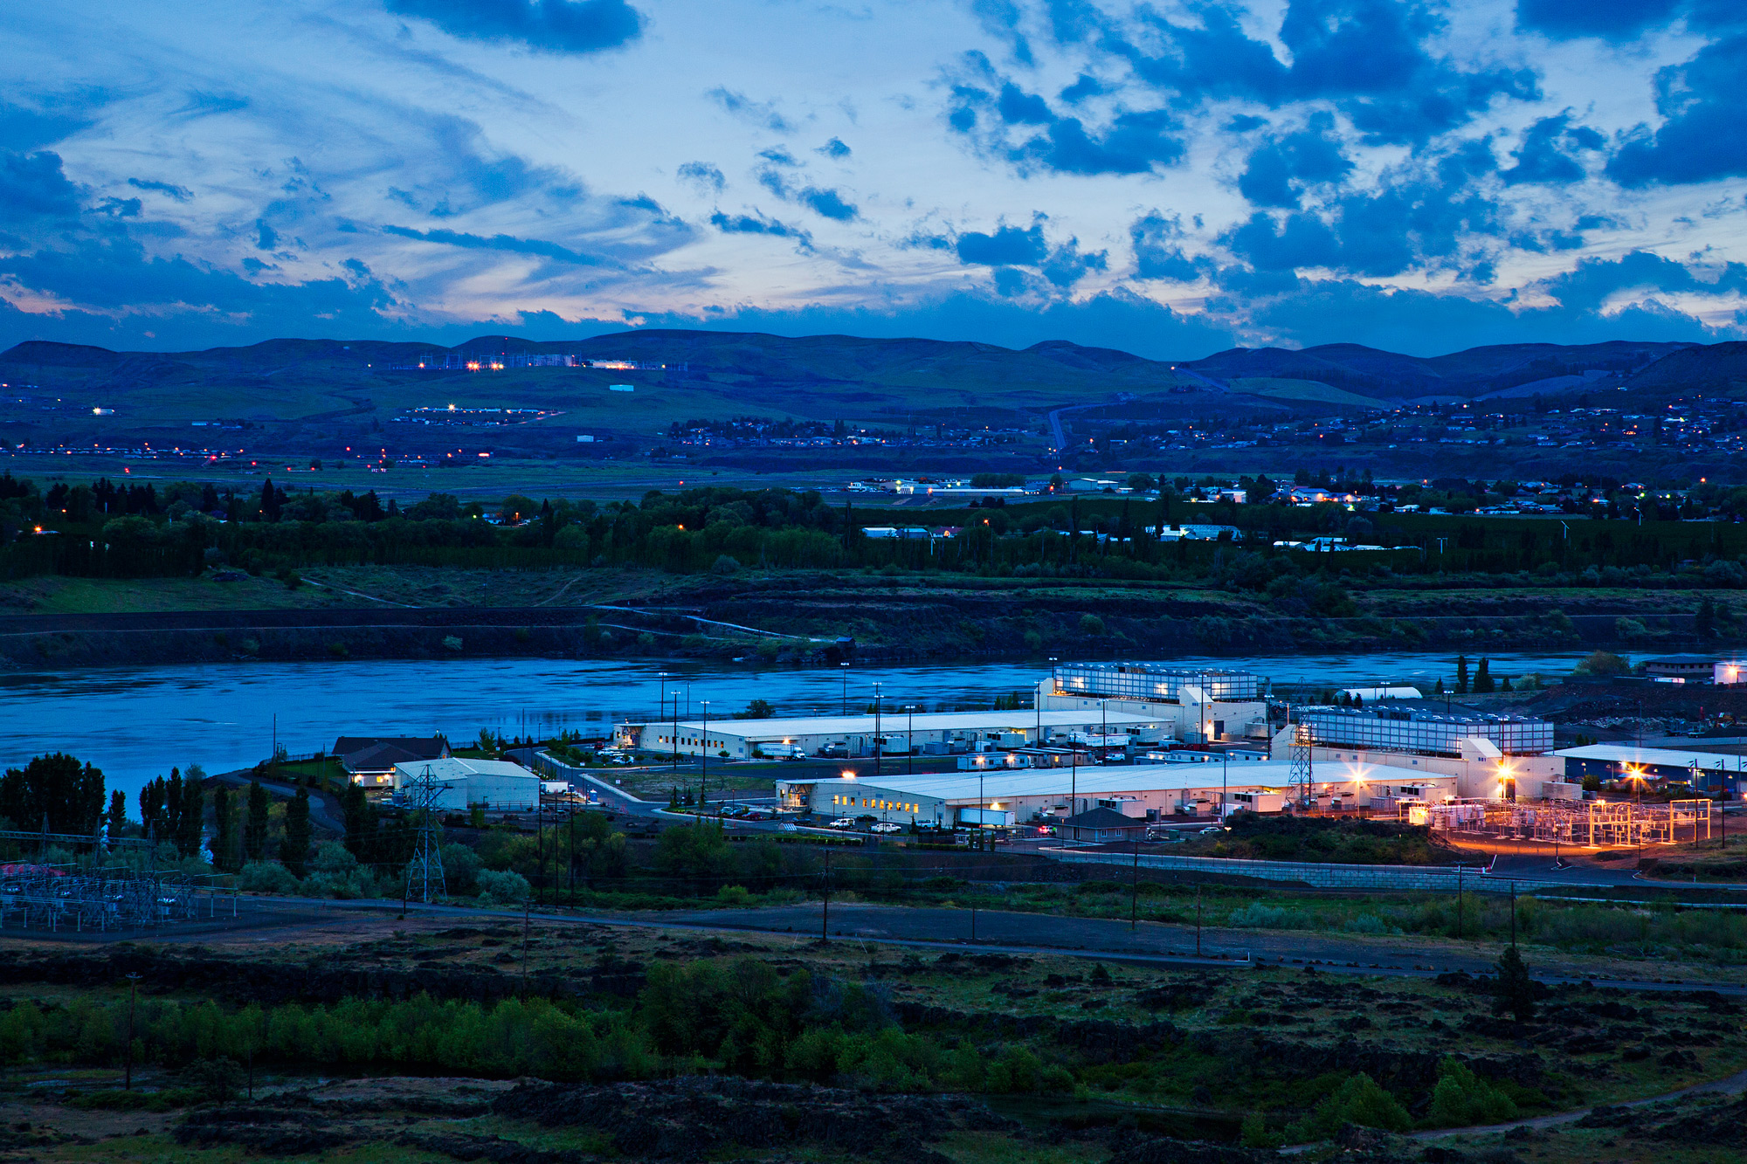
Datacenters run the world
Source: Google

Slide 4
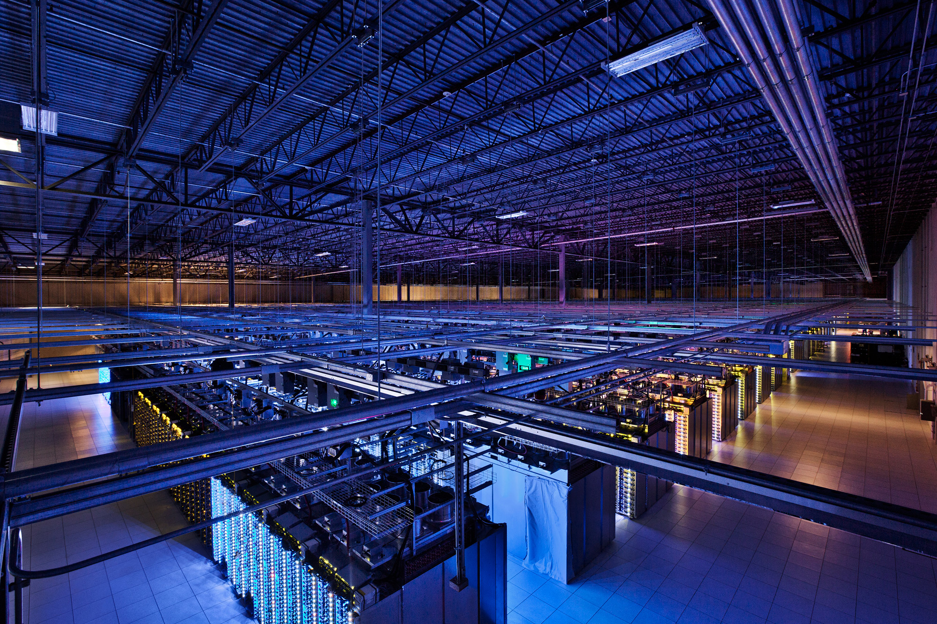
Datacenters run the world
Source: Google

Slide 5
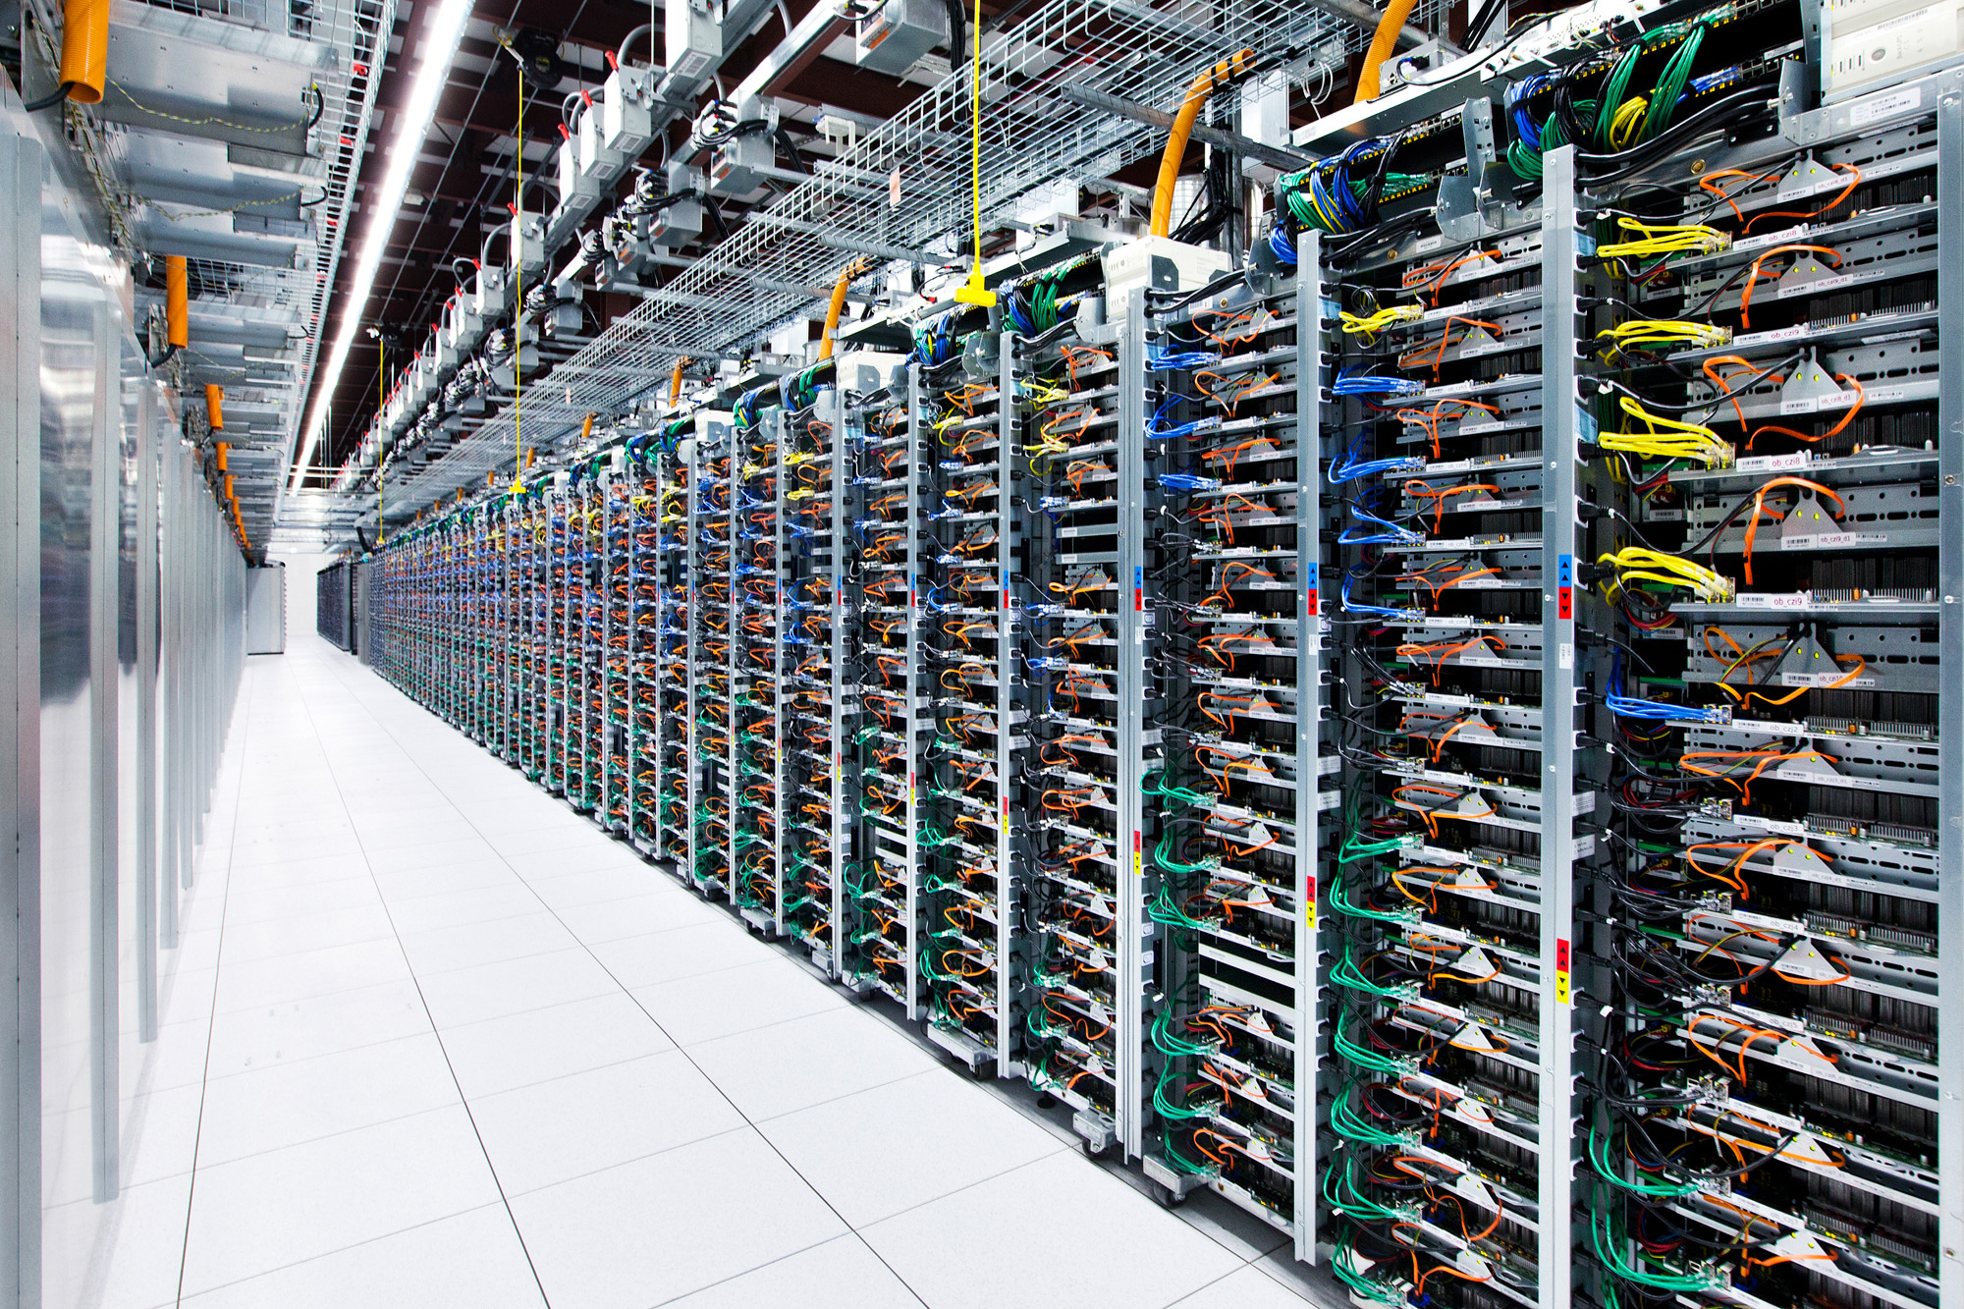
Datacenters run the world
Source: Facebook

Slide 6
How big is a datacenter (DC)?
1M servers/site [Microsoft/Amazon/Google]
> $1B to build one site [Facebook]
>$20M/month/site operational costs [MS’09]
Data center hardware spending will grow to $177 billion in 2017. [Gartner report]
But only O(10-100) sites

Slide 7
Implications (1)
Scale
Need scalable designs: e.g., avoid flooding
Low-cost designs: e.g., use commodity technology
High utilization (efficiency): e.g., >80% avg. utilization
Contrast: avg. utilization on Internet links often ~30%
Tolerate frequent failure
Large number of (low cost) components
Automate

Slide 8
Implications (2)
Service model: clouds / multi-tenancy
Performance guarantees
Isolation guarantees
Portability

Slide 9
Applications
Common theme: parallelism
Applications decomposed into tasks
Running in parallel on different machines
Two common paradigms
Partition-Aggregate
Map-Reduce

Slide 10


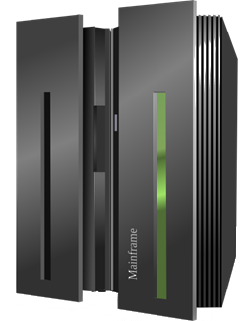
Partition-Aggregate
Mosharaf
Top-level Aggregator
Mid-level Aggregators
Workers

Slide 11

Partition-Aggregate
Mosharaf
Top-level Aggregator
Mid-level Aggregators
Workers

Slide 12
Map-Reduce
Map Stage
Reduce Stage
The most popular software that follows this paradigm is Apache Spark

Slide 13
Datacenter networks
Aggregation
ToR Switch
Server

Slide 14
Datacenter networks (Cont.)
Core
Aggregation
Rack

Slide 15
Datacenter traffic
Core
North-South Traffic
Aggregation
Rack
East-West Traffic

Slide 16
East-West traffic
Traffic between servers in the datacenter
Communication within “big data” computations
Traffic may shift on small timescales (< minutes)

Slide 17
Datacenter traffic characteristics
Two key characteristics
Most flows are small
Most bytes come from large flows
Applications want
High bandwidth (large flows)
Low latency (small flows)

Slide 18
High bandwidth
Ideal: Each server can talk to any other server at its full access link rate
Conceptually: Datacenter network as one giant switch

Slide 19
Datacenter network as one giant switch

Slide 20
Datacenter network as one giant switch

Slide 21
Datacenter network as one giant switch
One
GIANT
Switch

Slide 22
High bandwidth
Ideal: Each server can talk to any other server at its full access link rate
Conceptually: Datacenter network as one giant switch
Would require a 10 Pbits/sec switch!
1M ports (one port/server)
10Gbps per port
Practical approach: build a network of switches (“fabric”) with high “bisection bandwidth”
Each switch has practical #ports and link speeds

Slide 23
Bisection bandwidth
Partition a network into two equal parts
Minimum bandwidth between the partitions is the bisection bandwidth
Full bisection bandwidth: bisection bandwidth in an N node network is N/2 times the bandwidth of a single link
Nodes of any two halves can communicate at full speed with each other

Slide 24
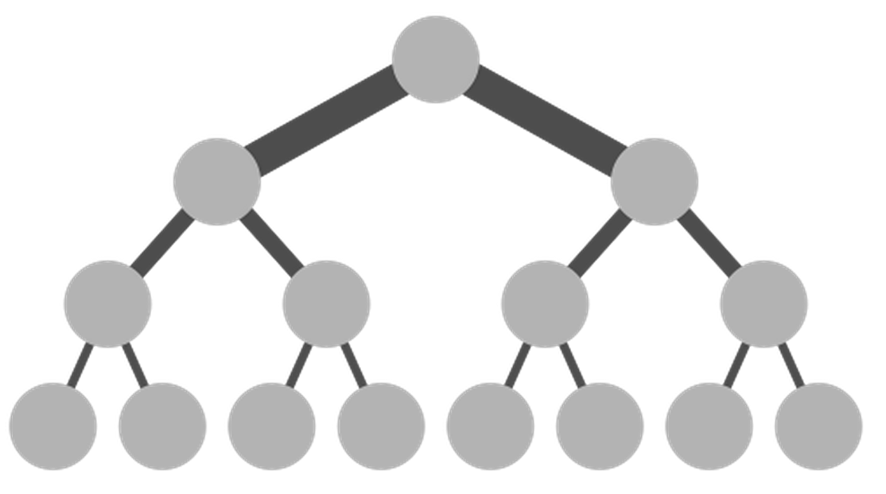
Achieving full bisection bandwidth
Scale up
Make links fatter toward the core of the network
Problem: Scaling up a traditional tree topology is expensive!
Requires non-commodity / impractical / link and switch components
Solutions?
Over-subscribe (i.e., provision less than full BBW)
Better topologies

Slide 25
Oversubscription
40G
20G
20G
10G
10G
10G
Need techniques to avoid congesting oversubscribed links!

Slide 26
Oversubscription
Not enough bandwidth
Oversubscription: Less bandwidth in the ToR-Agg links than all the servers bandwidth in the rack
Oversubscription ratio: Ratio between bandwidth underneath and bandwidth above
Not enough paths between server pairs
Load balancing issues
Failure recovery issues

Slide 27
Better topologies
Core
Aggregation
Rack

Slide 28
Better topologies
Core
Aggregation
Rack

Slide 29
Clos topology
Multi-stage network
k pods, where each pod has two layers of k/2 switches
k/2 ports up and k/2 down
All links have the same b/w
At most k³/4 machines
Example
k = 4
16 machines
For k=48, 27648 machines
Pod 1
Pod 2
Pod 3
Pod 4

Slide 30
Challenges in scale-out designs?
Topology offers high bisection bandwidth
All other system components must be able to exploit this available capacity
Routing must use all paths
Transport protocol must fill all pipes (fast)

Slide 31
5-minute break!

Slide 32
Datacenter traffic characteristics
Two key characteristics
Most flows are small
Most bytes come from large flows
Applications want
High bandwidth (large flows)
Low latency (small flows)

Slide 33
Very low RTTs within the DC
Implications of O(1) μsec latency
BW x delay
10Gbps x 1μsec = 10000 bits = 2.5 500-Byte packets
Consider TX 500B @ 10Gbps = 0.4μs per hop = 2μs if a packet traverses 5 hops and waits behind one packet at every hop
What does this mean for buffering and switch design?
What does this mean for congestion control?

Slide 34
Application-level latency requirements
Applications want low latency
Predictable / guaranteed bounds on flow completion time, including the worst-case!
How is still an open question

Slide 35
What’s different about DC networks?
Characteristics
Huge scale
~20,000 switches/routers
Contrast: AT&T ~500 routers

Slide 36
What’s different about DC networks?
Characteristics
Huge scale
Limited geographic scope
High bandwidth: 10/40/100G (Contrast: DSL/WiFi)
Very low RTT: 1-10s μsecs (Contrast: 100s msecs)

Slide 37
What’s different about DC networks?
Characteristics
Huge scale
Limited geographic scope
Limited heterogeneity
Link speeds, technologies, latencies, …

Slide 38
What’s different about DC networks?
Characteristics
Huge scale
Limited geographic scope
Limited heterogeneity
Regular/planned topologies (e.g., trees)
Contrast: ad-hoc evolution of wide-area topologies

Slide 39
What’s different about DC networks?
Goals
Extreme bisection bandwidth requirements
Recall that all east-west traffic use it
Target: any server can communicate at its full link speed
Target: making impactful use of this bandwidth by leveraging application-level knowledge
How: Next lecture

Slide 40
What’s different about DC networks?
Goals
Extreme bisection bandwidth requirements
Extreme latency requirements
Affects user-facing applications
Target: 1μs RTTs
Target: Minimize flow completion time
How: Next lecture

Slide 41
What’s different about DC networks?
Goals
Extreme bisection bandwidth requirements
Extreme latency requirements
Predictable, deterministic performance
“Your packet will reach in Xms, or not at all”
“Your VM will always see at least YGbps throughput”
How: Still an open question

Slide 42
What’s different about DC networks?
Goals
Extreme bisection bandwidth requirements
Extreme latency requirements
Predictable, deterministic performance
Differentiating between tenants is key
“No traffic between VMs of tenant A and tenant B”
“Tenant X cannot consume more than XGbps”
“Tenant Y’s traffic is low priority”
How: Mechanism can be SDN, but there are many policies without any consensus

Slide 43
What’s different about DC networks?
Goals
Extreme bisection bandwidth requirements
Extreme latency requirements
Predictable, deterministic performance
Differentiating between tenants is key
Scalability

Slide 44
What’s different about DC networks?
Goals
Extreme bisection bandwidth requirements
Extreme latency requirements
Predictable, deterministic performance
Differentiating between tenants is key
Scalability
Cost/efficiency
Focus on commodity solutions, ease of management

Slide 45
What’s different about DC networks?
New degrees of (design) freedom
Single administrative domain
Can deviate from standards, invent your own, etc.
Clean-slate deployment is still feasible

Slide 46
What’s different about DC networks?
New degrees of (design) freedom
Single administrative domain
Control over network and endpoint(s)
Can change (say) addressing, congestion control, etc.
Can add mechanisms for security/policy/etc. at the endpoints (typically in the hypervisor)

Slide 47
What’s different about DC networks?
New degrees of (design) freedom
Single administrative domain
Control over network and endpoint(s)
Control over the placement of traffic source/sink
Map-reduce scheduler chooses where tasks run
Distributed file system dictates where data blocks are replicated
Can control what traffic crosses which links

Slide 48
Summary
Datacenters
New characteristics and goals ⇒ new opportunities
Scalability is the baseline requirement
More emphasis on performance, both on bandwidth and latency
Less emphasis on heterogeneity
Less emphasis on interoperability
Next lecture: networking in datacenters
Notes:
-- incast?
-- one big switch abstraction…

